Slide 1

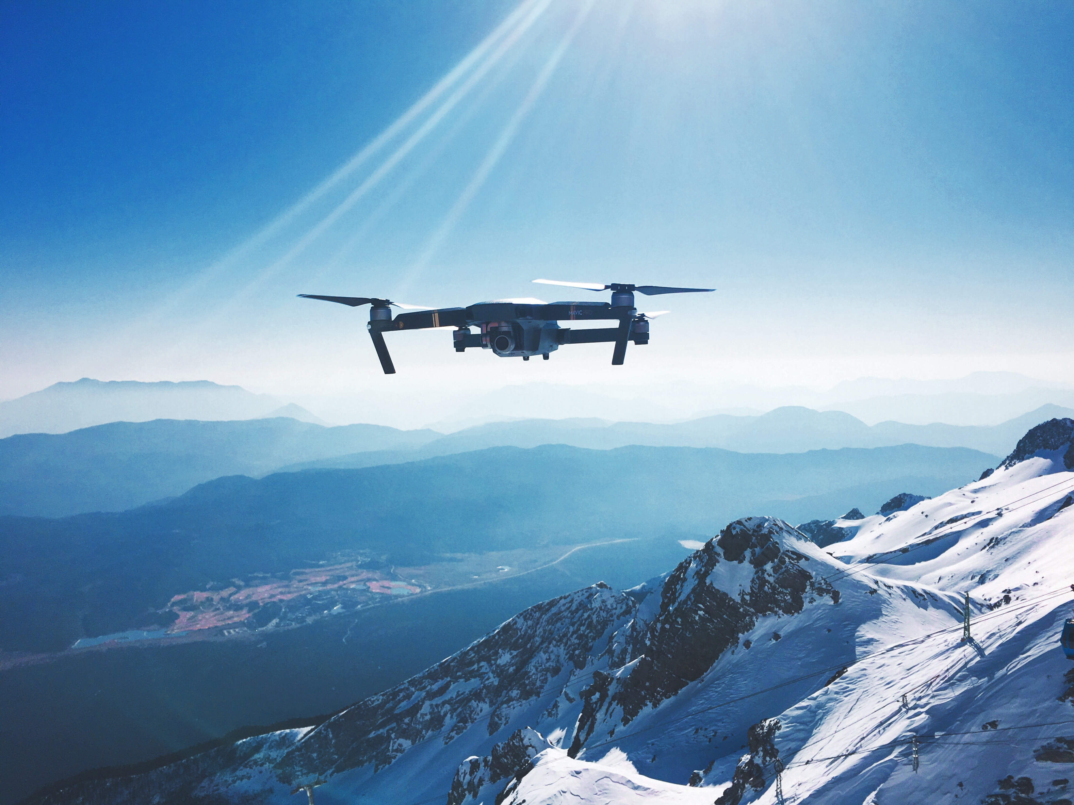

AVIATO
SOCIETY OF AUTOMOTIVE ENGINEERS
National Institute Of Technology, Srinagar.

Slide 2
Technical Content [A]
1.1. Conceptual Design
1.2 Preliminary Weight Estimation
1.3 Thrust Required Estimation &
Propulsion System Selection
1.4. UAV Sizing
1.5. UAV Performance
1.6. Material Selection
1.7. Subsystem Selection
1.8. C.G. & Stability
1.9 Preliminary CAD
1.10. Computational Analysis
1.11. Optimized Final Design
1.12. Detailed Weight Breakdown, UAV Performance Recalculation

Slide 3
1.1 CONCEPTUAL DESIGN
Upon careful analysis of the requirements and thorough comprehension of the problem statement, our team, Team Aviato, has made the decision to develop a quadcopter.
This quadcopter will feature a unique and CUSTOM-DESIGNED DRONE FRAME exclusively crafted by our team

Slide 4
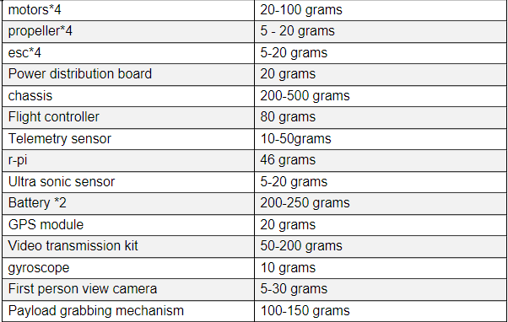
1.2 PRELIMINARY WEIGHT ESTIMATION
The table beside gives you a detailed weight estimation.
Maximum weight of drone =2.186kg
Minimum weight of drone=1.066 kg
payload=200 grams.

Slide 5
1.3 THRUST REQUIRED ESTIMATION & PROPULSION SYSTEM SELECTION
Given an estimated weight of approximately 2000 grams for our quadcopter, it is prudent to maintain a
1.5:1 THRUST-TO-WEIGHT ratio.
Therefore, we have determined that generating a total thrust of 3200 grams will be sufficient, considering additional flight operations such as hovering.
To distribute this thrust evenly among the four motors, we aim for approximately 800 grams of thrust per motor.
This calculation takes into account the customized chassis and serves as a precautionary measure to ensure safe and stable flight operations.
Motor used is 1000kV BLDC Hence, thrust provided by each motor = 800 g approx.
Therefore , total thrust provided by all motors = 800*(no. Of motors) = 800*4
Total thrust provided to drone = 3200 g approx.

Slide 6
1.3 THRUST REQUIRED ESTIMATION & PROPULSION SYSTEM SELECTION
The data-driven reasons for selecting the motor and propeller as the propelling system for our drone are listed below.
Efficiency
Weight-to-Thrust Ratio
Control and Maneuverability
Noise Levels
Scalability and Customization
Safety
The high efficiency and favorable weight-to-thrust ratio of electric motors and propellers contribute to increased flight performance, longer flight times, and improved payload capacity. Their precise control allows for agile maneuverability, while lower noise levels enhance operational versatility. Furthermore, scalability and customization options provide flexibility in meeting specific design requirements. Finally, the safety. The advantages of motor and propeller systems make them a reliable choice for UAV applications.

Slide 7
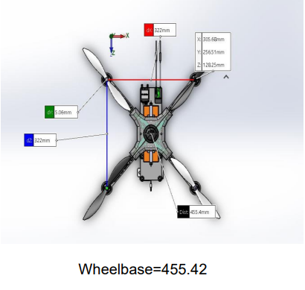
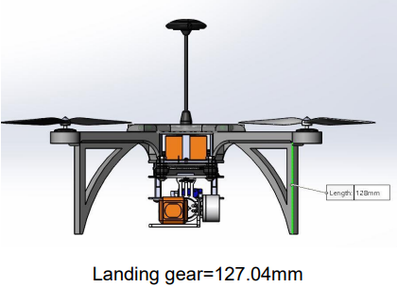
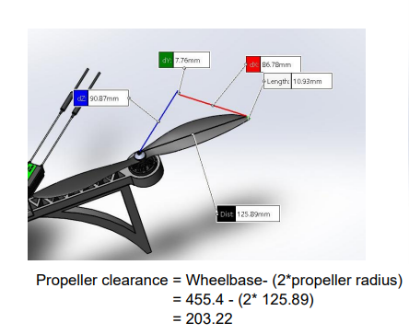
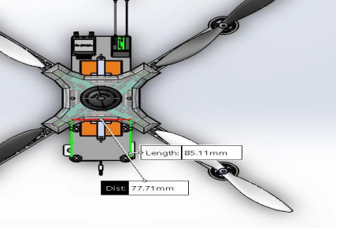
1.4 UAV SIZING
Team Aviato has strived to create a UAV that exhibits
Maximum strength
Efficient material usage,
Excellent aerodynamics.
The UAV sizing for the same is jotted below.
Rotor Arm = 177.81mm
Wheelbase = 455.42mm
Propeller Clearance = 203.22 mm
Landing gear =128 mm
hub = 155.15 x 155.15 mm

Slide 8
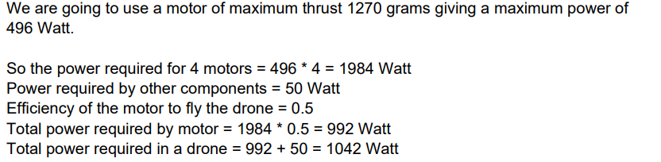
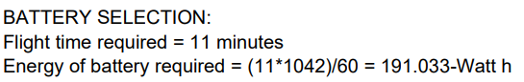
1.5 UAV PERFORMANCE
The crucial aspect of UAV performance depends on the motor and battery used, to meet the performance requirement.
Team Aviato will be using
MOTOR: DYS D3536-8 1000 KV BLDC Motor
BATTERY: Orange 22.2V 8000mAh 25C 6S Lithium Polymer Battery Pack
to meet the requirement as shown in the calculation beside.

Slide 9
1.6 MATERIAL SELECTION
When it comes to choosing a material for the drone chassis, there are several options to consider, including plastic, carbon fiber, and glass fiber. In the case of Team Aviato, we have carefully evaluated these options and decided to justify our choice of plastic as the primary material over carbon fiber and glass fiber.
The material selection is based on various factors, such as
Cost-effectiveness
Ease of manufacturing
Impact resistance
Flexibility
Weight reduction
Considering the above-stated factors Team Aviato has decided PLASTIC as the drone material, as we can achieve a cost-efficient, reliable, and customizable solution that meets our specific requirements while still delivering high-performance drones.

Slide 10
1.7 SUBSYSTEM SELECTION
Subsystems for Communication unit:
1. RC Receiver: Radio link R12DS
Reasons for selection: 4 km control distance, 12 channels, compatibility with Pixhawk flight controller.
2. Data Telemetry: ZOONv1
Reasons for selection: Global frequency coverage, ranging from 6 km to 21 km (depending on data bandwidth configuration), hassle-free mesh functionality for MAVLINK packets, Cha-cha 20 encryption.
3. Video Telemetry: TS832
Reasons for selection: Transfers videos in NTSC/PAL format, lightweight and small size, operate at high temperatures, suitable voltage range.
4. RC Controller: Radiolink AT10
Reasons for selection: Operates on 2.4 GHz frequency, eliminates interference and glitching from other electronic components on the drone
Subsystem for control and navigation unit:
1. Flight Controller (Pixhawk 4):
It has various onboard sensors like a magnetometer, barometer, accelerometer, gyroscope, and temperature sensor for smooth control of the motion. We decided to use Pixhawk 4 over other flight controllers as it features more computing power and 2X the RAM than the previous versions. It also has additional ports for better integration and expansion, new sensors, and integrated vibration isolation. Also on comparing its weight to usability ratio is more than those of its competitors.
2. GPS Module(GPS Module GPS NEO-M8N BDS Compass Module(3 in 1)) :
This GPS Module can measure with a time accuracy of 60 ns. Also, it can work with good consistency in the temperature range of -40 to 85 degrees Celsius as it comes up with the main chip U-B-LOX M8030 KT and Built-in TCXO. Also, it has a wide range of use for APM flight controller; PIX flight controller; PX4 flight controller; the outlet terminal is directly compatible with the APM serial port and I2C port. Plug-and-play other flight controllers are also available in it

Slide 11
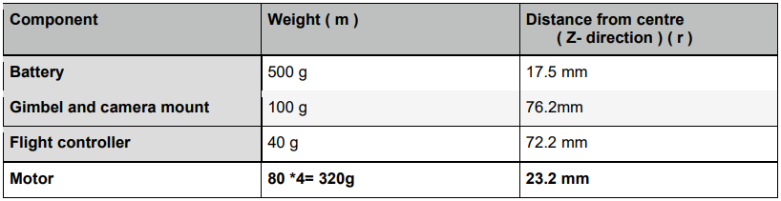
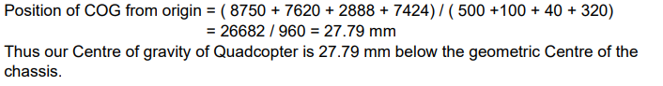
1.8 C.G & STABILITY
CG Estimation
We have designed the chassis to be symmetric when viewed from the top.
This means that the center of gravity of our quadcopter can only shift in y direction.
Here we will neglect the lighter components and consider only those components that can change the Centre of gravity significantly.
We will take the center of the chassis as our origin.
NOTE: We did not consider the weight of the chassis as we are taking the origin at the geometric Centre of chassis and we have assumed that the geometric Centre of the chassis and Centre of gravity of the chassis are at the same position.

Slide 12
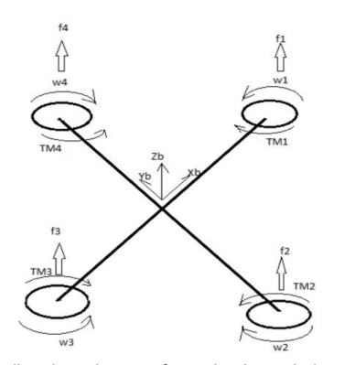
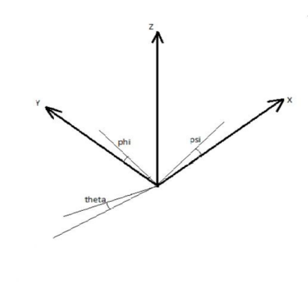
1.8 C.G & STABILITY
The body of a quadcopter is supposed as a rigid body and the following assumptions are considered:
Mass distribution is assumed constant.
The structure is rigid and symmetrical.
The origin of the center of gravity and fixed body frame coincides.
The dynamics of quadcopter include subsystems of motion which are translational and rotational and both frames are references for the equation of motions and dynamics. For stability analysis,
we used the following dynamic equations: Position vector: 𝜉=[𝑥𝑦𝑧] ɳ=[∅𝜃𝜑]
Euler Angles: The orientation of the drone is described by Euler angles.
Rotation with respect to x - roll angle.
Rotation with respect to y - pitch angle.
Rotation with respect to z - yaw angle
Figure to be referred for position vector & Euler angles
The structure of the quadcopter and its angular velocities and torques are represented in the figure individually for 4 rotors in the above-pasted figure. (W indicates angular velocity TM indicates torque f indicates force.)

Slide 13
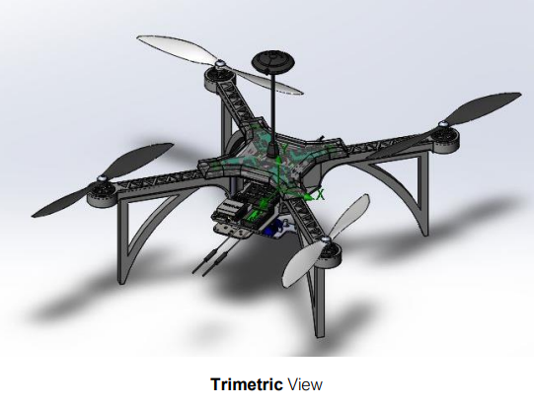
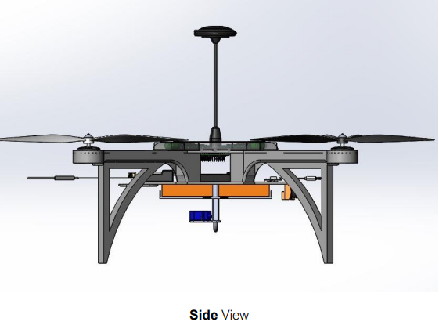
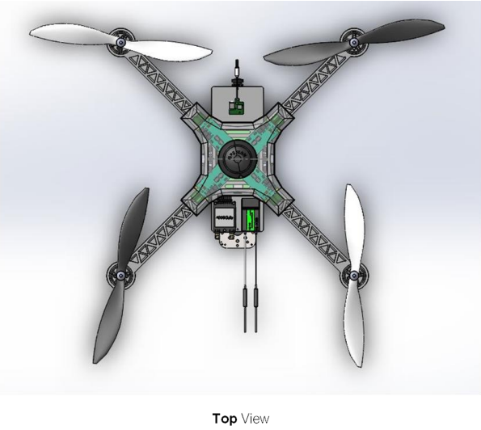
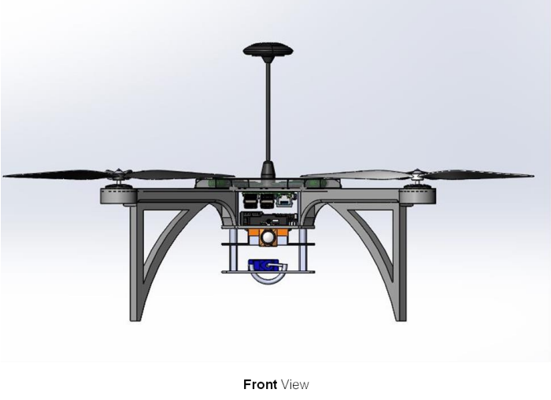
1.9 PRELIMINARY CAD
Team Aviato’s preliminary cad model for the quadcopter.

Slide 14
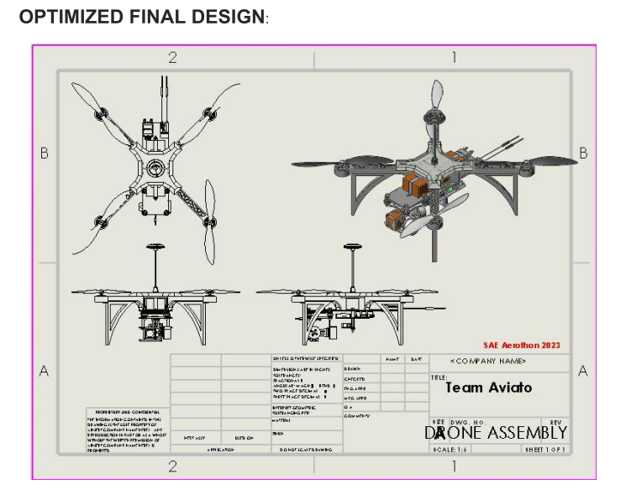
1.10 COMPUTATIONAL ANALYSIS
Team Aviato has successfully conducted a comprehensive computational analysis of our drone design using Autodesk Fusion 360.
Through diligent effort and iterative design changes, we have achieved remarkable improvements in the STRUCTURAL INTEGRITY and SAFETY of our drone.
The safety factor of the drone is increased from 0.38 to 10.06 during the computational analysis.

Slide 15
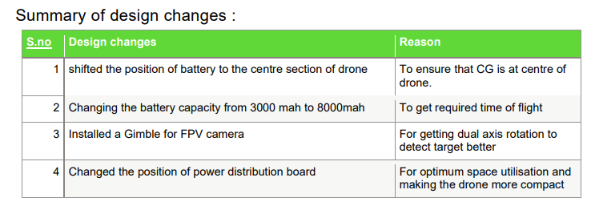
1.10 COMPUTATIONAL ANALYSIS

Slide 16
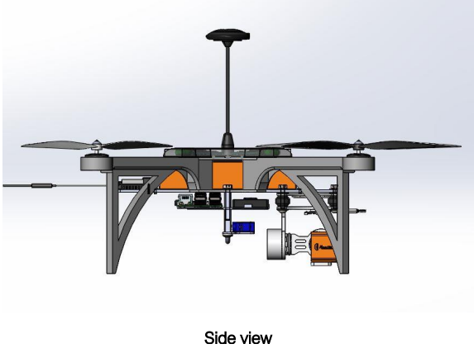
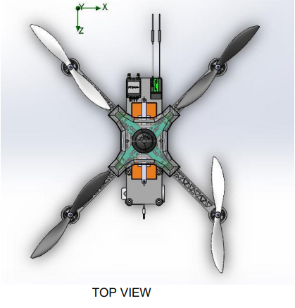
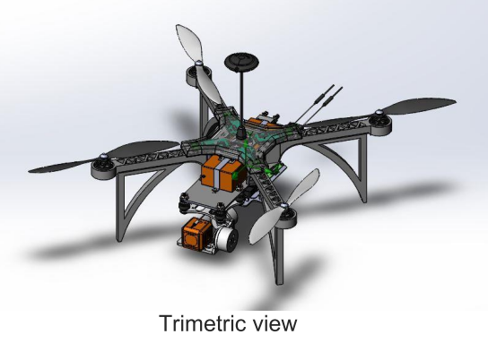
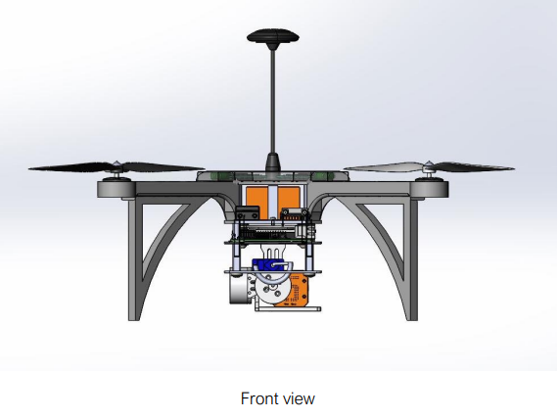
1.11 OPTIMIZED FINAL DESIGN

Slide 17
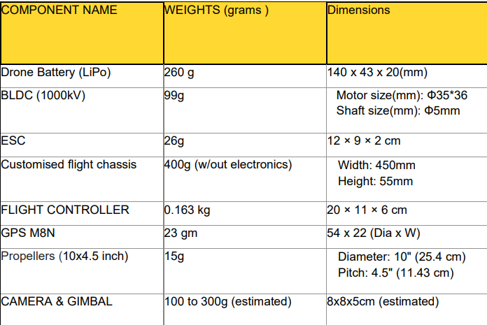
1.12 DETAILED WEIGHT BREAKDOWN & UAV PERFORMANCE CALCULATION

Slide 18
Methodology for Autonomous Operation [B]
2.1 Autonomous Flight
2.2 Autonomous Identification of Target
2.3 Autonomous Payload Drop

Slide 19
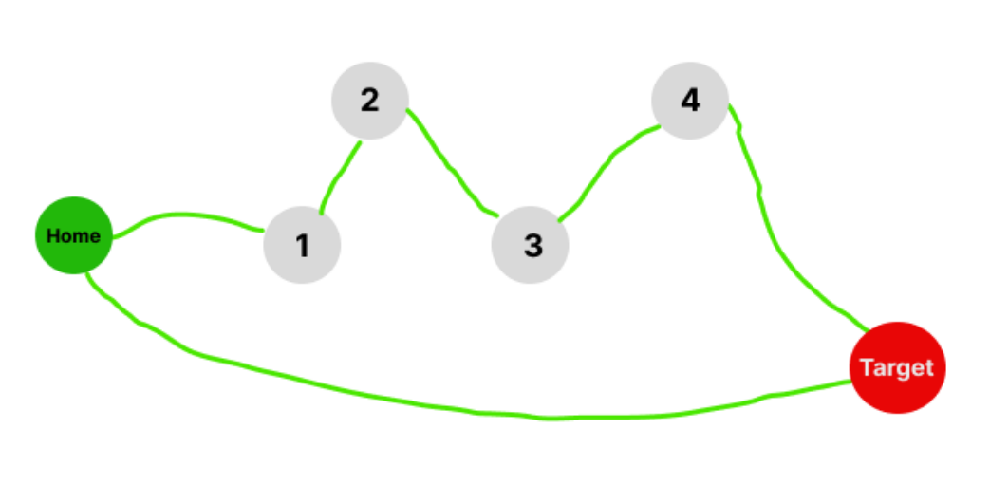
2.1 Autonomous Flight
Steps for autonomous flight are enlisted below.
Initial setup
Waypoint setup
Home to hotspot
Hotspot to target
Target to home
Figure : Autonomous operation

Slide 20
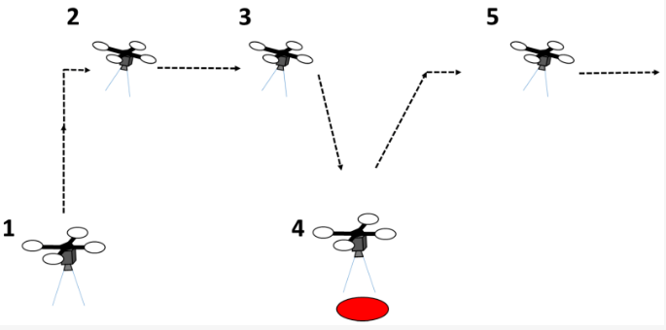
2.2 Autonomous Identification of Target

Slide 21
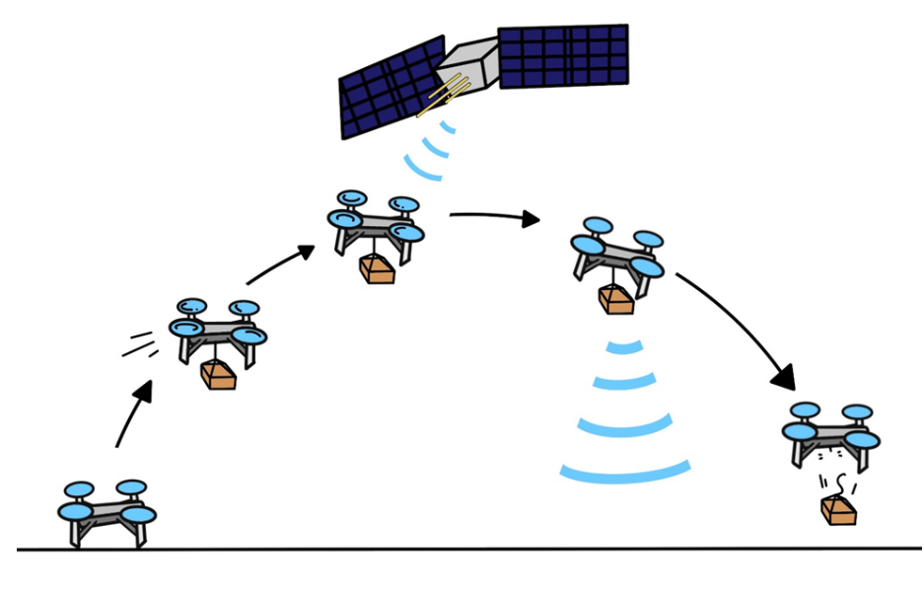
2.3 Autonomous Payload Drop

Slide 22
INNOVATION [C]

Slide 23
3.1 Innovation
Self developed quadcopter using 3D printable chassis.
Outstanding value of factor of safety 10.06
Well-designed Payload mechanism using a simple servo motor and a hook.

Slide 24
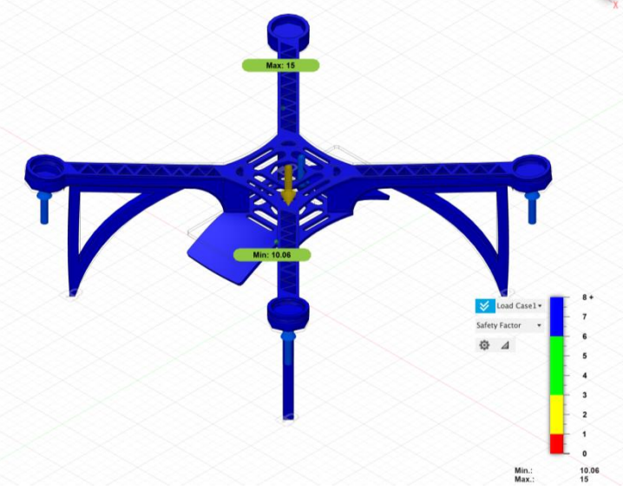
3.1 Innovation
FIGURE: TESTED SAFETY FACTOR OF 10.06

Slide 25
THANK YOU!

